Slide 1
Introduction to Scala

Slide 2
What is SCALA?
SCALA stands for scalable Language.
Scala is a general-purpose programming language. It supports object oriented, functional and imperative programming approaches. It is a strong static type language.
In scala, everything is an object whether it is a function or a number. It does not have concept of primitive data.

Slide 3
It was designed by Martin Odersky. It was officially released for java platform in early 2004 and for .Net framework in June 2004. Later on, Scala dropped .Net support in 2012.
Scala is influenced by Java, Haskell, Lisp, Pizza etc. and influenced to F#, Fantom, Red etc.
Scala Allows you to call Java methods, access java fields, inherit from java classes and implement java interfaces in your code without the added requirements of any special syntax.
File extension of scala source file may be either .scala or .sc.

Slide 4
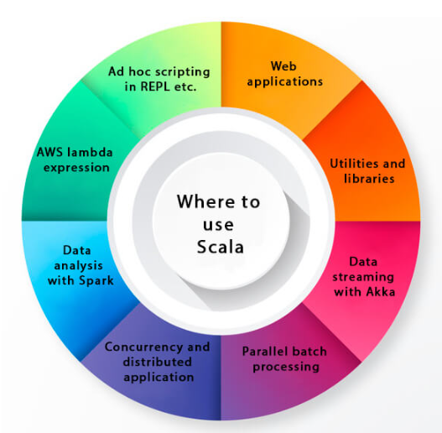
Applications of scala

Slide 5
Scala is used in Data Processing, Distributed Computing, and Web Development.
It powers the data engineering infrastructure of many companies.
Companies like Twitter, Linkedln, Sony, Netflix, Quora, Tumblr and Foursquare use Scala regularly in their programs.

Slide 6
Needs to learn Scala
High in demand
Scala syntax is precise
Scala pays well
The best of both worlds ( Functional & Object-oriented Programming)
Scala is growing
Scala has some cool features

Slide 7
A ‘Scalable’ Language
Scalability is the property of a language to grow with an increase in demands.
Most prominent reason of Scala being a scalable language is its combination of being both object-oriented and functional.

Slide 8
Scala is a pure object-oriented language in the sense that every value is an object and every operation is a method call.
While it is a pure object-oriented programming language, scala is also fully functional.
Scala is a functional language in the sense that every function is a value.

Slide 9
Features of Scala
There are following features of Scala:
Type inference
Singleton object
Immutability
Lazy computation
Case classes and Pattern matching
Concurrency control
String interpolation
Higher order function
Traits
Rich collection set

Slide 10
Type Inference
In Scala, you don't require to mention data type and function return type explicitly.
Scala is enough smart to deduce the type of data.
The return type of function is determined by the type of last expression present in the function.

Slide 11
Singleton object
In Scala, there are no static variables or methods. Scala uses singleton object, which is essentially class with only one object in the source file.
Singleton object is declared by using object instead of class keyword.

Slide 12
Immutability
Scala uses immutability concept. Each declared variable is immutable by default. Immutable means you can't modify its value. You can also create mutable variables which can be changed.
Immutable data helps to manage concurrency control which requires managing data.

Slide 13
Lazy Computation
In Scala, computation is lazy by default. Scala evaluates expressions only when they are required. You can declare a lazy variable by using lazy keyword. It is used to increase performance.

Slide 14
Case classes and Pattern matching
Scala case classes are just regular classes which are immutable by default and decomposable through pattern matching.
All the parameters listed in the case class are public and immutable by default.
Case classes support pattern matching. So, you can write more logical code.

Slide 15
Concurrency control
Scala provides standard library which includes the actor model. You can write concurrency code by using actor. Scala provides one more platform and tool to deal with concurrency known as Akka. Akka is a separate open source framework that provides actor-based concurrency. Akka actors may be distributed or combined with software transactional memory.

Slide 16
Higher Order Functions
Higher order function is a function that either takes a function as argument or returns a function. In other words, we can say a function which works with another function is called higher order function.
Higher order function allows you to create function composition, lambda function or anonymous function etc.

Slide 17
Rich Set of Collection
Scala provides rich set of collection library. It contains classes and traits to collect data. These collections can be mutable or immutable. You can use it according to your requirement. Scala.collection.mutable package contains all the mutable collections. You can add, remove and update data while using this package.
Scala.collection.immutable package contains all the immutable collections. It does not allow you to modify data.

Slide 18
Variable in Scala
A variable is a small box used to store data.
When we assign a value to a variable, we are basically putting something in a box.
When you declare a variable, you give it a unique name, define the type of data it can store, and set its initial value.
While most programming languages have a similar way of declaring variables, Scala is a little different.

Slide 19
Declaring a Variable
Syntax:
keyword variableName: DataType = Initial Value
Example:
val myFirstScalaVariable:Int = 5

Slide 20
In the last example, we are declaring a variable with the name myFirstScalaVariable.
myFirstScalaVariable can store data of type Int and is assigned an initial value of 5.
It is an immutable variable because we choose the keyword val.

Slide 21
How to choose right keyword ?
Variables of type val are immutable variables, i.e. once they are initialized they can never be reassigned.
Variables of type var are mutable variables, i.e. they can be reassigned throughout their lifetime as long as they are built.

Slide 22
Hello world in Scala
Hello world program in scala looks like:
print(“hello world!”)

Slide 23
Printing methods in Scala
Print
Println
printf

Slide 24
print
Print is the simplest method for displaying output in Scala.
It just prints anything you pass it, one after the other in the same line.
Example:
print(“Hello World!”)
print(3)

Slide 25
println
Println is used if you want to display each specific output on separate lines.
With each println statement, the output is automatically displayed on the next line.
Example:
println(“Hello world”)
println(3)

Slide 26
printf
Printf is used for formatting text.
You can use it to append different data types to your text that is to be printed.
Example:
printf(“Number=%d”, 123)
It will print Number=123, It recognize that %d.

Slide 27
Paste mode
We can run multiple commands on Scala shell using paste mode.
i.e. to enter in paste mode use:
:paste
To exit paste mode use ctrl+D.

Slide 28
Immutable Variables in Scala
Immutable is defined as unchangeable and is precisely what an immutable variable is i.e. unchangeable.
Immutable variables are basically like constants i.e. once they are assigned a value, that value can never be changed.
To declare an immutable variable we use the val keyword.
In Scala, the general rule is to use the val keyword unless there is a good reason not to.

Slide 29
Mutable Variables
Mutable is defined as something that can be altered, and mutable variables are just the same i.e. variables whose values can be changed.
To declare a mutable variable, we use the keyword var.

Slide 30
Example
val message:String=“hello world”
message=“new message”
Now there will be an error message i.e. reassignment to val hence immutable.
var msg:String=“hello”
msg=“hi”
print(msg)
This will reassign the updated value to variable i.e. mutable type

Slide 31
Data Types in Scala
In Scala, every value has a type and each type is part of a type hierarchy.
In a type hierarchy, the more generic types are at the top and as you go lower in the hierarchy, the types get more specific.

Slide 32
Scala Type Hierarchy
At the top of the type hierarchy in Scala, we have type Any.
It is the super-type and defines certain universal methods such as equals, hashCode, and toString.
Any has two subclasses, namely AnyVal and AnyRef.
AnyVal represents value types.
There are nine main value types supported in Scala.

Slide 33
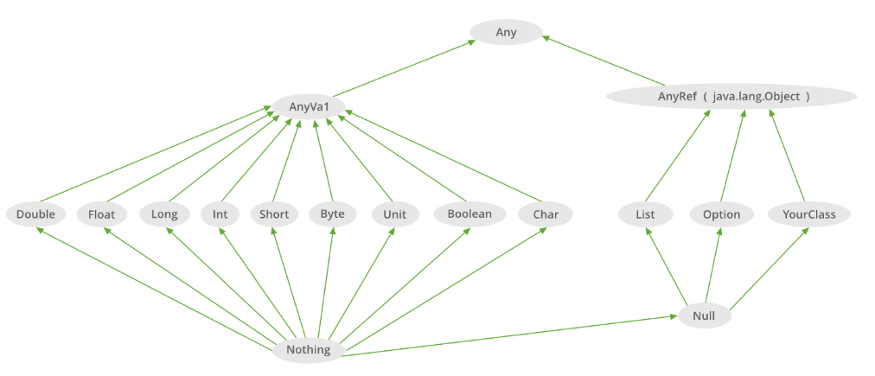
Scala Type Hierarchy

Slide 34
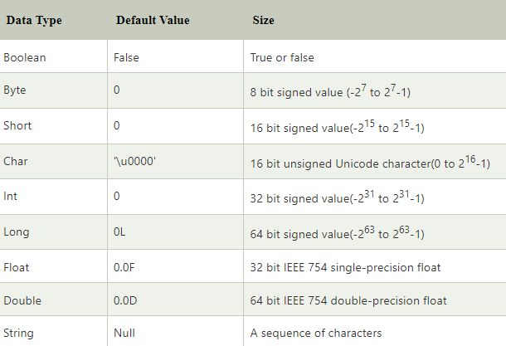
Value Types in Scala

Slide 35
AnyRef represents reference types.
Any type that is not a value type is a reference type, including types defined by users not predefined in Scala.

Slide 36
Value Type VS Reference Type
Imagine you have a piece of paper.
You want the paper to hold some information, such as your name.
You can write your name on the piece of paper therefore the value of the paper is the same as the information it provides.
This is an example of value type.

Slide 37
Value Type VS Reference Type
Now imagine, you want the paper to hold your house.
That’s not physically possible so you write the address to your house, hence the value of the paper is a reference to the required information.

Slide 38
Value Type VS Reference Type
In the same way, a reference type holds the memory address location of the value, while value types hold the value themselves.

Slide 39
Using Value Types
Val myDoubleVariable:Double=2.75
Val myFloatVariable:Float=2.75f
Val myLongVariable:Long=2750000L
Val myIntVariable:Int=275
Val myShortVariable:Short=1
Val myByteVariable:Byte=0xa
Val myCharVariable:Char=‘a’
Val myUnitVariable:Unit=()
Val myBooleanVariable:Boolean=true

Slide 40
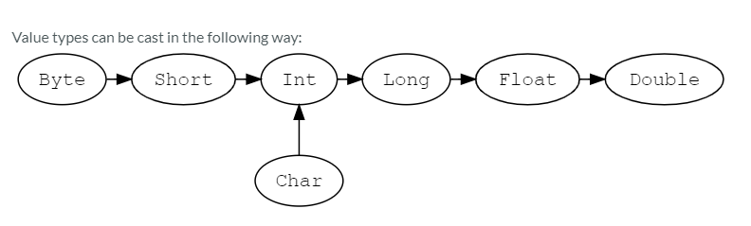
Type Casting in Scala
Type casting is the process where we change the data type for any value of a variable to a new type than it was defined earlier.

Slide 41
The arrows in the diagram are giving the direction of conversion.
For Example, a float can be converted to a double, but a double cannot be converted to a float.

Slide 42
Type Casting Examples
Long=> Float
val oldType:Long=92637128
val newType:Float=oldType
val oldType:Long=92637128
val newType:Float=oldType
val newOldType:Long=newType

Slide 43
Example
Char=>Int
val oldType:Char=‘A’
val newType:Int=oldType

Slide 44
Operators in Scala
An operator is a symbol that represents an operation to be performed with one or more operand.
Operators are the foundation of any programming language. Operators allow us to perform different kinds of operations on operands.

Slide 45
Operators in Scala
There are different types of operators used in Scala as follows:
Arithmetic Operators
Relational Operators
Logical Operators
Bitwise Operators
Assignment Operators.

Slide 46
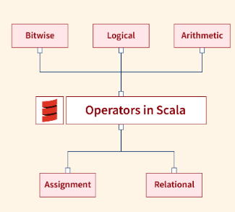

Slide 47
Arithmetic Operators
These are used to perform arithmetic/mathematical operations on operands.
Addition(+) operator adds two operands. For example, x+y.
Subtraction(-) operator subtracts two operands. For example, x-y.
Multiplication(*) operator multiplies two operands. For example, x*y.

Slide 48
Arithmetic Operators
Division(/) operator divides the first operand by the second. For example, x/y.
Modulus(%) operator returns the remainder when the first operand is divided by the second. For example, x%y.
Exponent(**) operator returns exponential(power) of the operands. For example, x**y.

Slide 49
Example
Arithmetic Operators:
Val operand1=10
Val operand2=7
Println(operand1+operand2)
Println(operand1-operand2)
Println(operand1*operand2)
Println(operand1/operand2)
Println(operand1%operand2)

Slide 50
Relational Operators
Relational operators or Comparison operators are used for comparison of two values. Let’s see them one by one:
Equal To(==) operator checks whether the two given operands are equal or not. If so, it returns true. Otherwise it returns false.
For example, 5==5 will return true.
Not Equal To(!=) operator checks whether the two given operands are equal or not. If not, it returns true. Otherwise it returns false. It is the exact boolean complement of the ‘==’ operator.
For example, 5!=5 will return false.
Greater Than(>) operator checks whether the first operand is greater than the second operand. If so, it returns true. Otherwise it returns false.
For example, 6>5 will return true.

Slide 51
Relational Operators
Less than(<) operator checks whether the first operand is lesser than the second operand. If so, it returns true. Otherwise it returns false.
For example, 6<5 will return false.
Greater Than Equal To(>=) operator checks whether the first operand is greater than or equal to the second operand. If so, it returns true. Otherwise it returns false.
For example, 5>=5 will return true.
Less Than Equal To(<=) operator checks whether the first operand is lesser than or equal to the second operand. If so, it returns true. Otherwise it returns false.
For example, 5<=5 will also return true.

Slide 52
Example
Relational Operators:
Val operand1=10
Val operand2=7
Println(operand1 > operand2)
Println(operand1 < operand2)
Println(operand1 >= operand2)
Println(operand1 <= operand2)
Println(operand1 != operand2)

Slide 53
Logical Operators
They are used to combine two or more conditions/constraints or to complement the evaluation of the original condition in consideration. They are described below:
Logical AND(&&) operator returns true when both the conditions in consideration are satisfied. Otherwise it returns false. Using “and” is an alternate for && operator.
For example, a && b returns true when both a and b are true (i.e. non-zero).

Slide 54
Logical Operators
Logical OR(||) operator returns true when one (or both) of the conditions in consideration is satisfied. Otherwise it returns false. Using “or” is an alternate for || operator.
For example, a || b returns true if one of a or b is true (i.e. non-zero). Of course, it returns true when both a and b are true.
Logical NOT(!) operator returns true the condition in consideration is not satisfied. Otherwise it returns false. Using “not” is an alternate for ! operator.
For example, !true returns false.

Slide 55
Example
Logical Operators:
val A =true
val B=false
val exp = A && B

Slide 56
Assignment Operators
Assignment operators are used to assigning a value to a variable. The left side operand of the assignment operator is a variable and right side operand of the assignment operator is a value.
The value on the right side must be of the same data-type of the variable on the left side otherwise the compiler will raise an error.

Slide 57
Types of assignment operators
Simple Assignment (=)
Add AND Assignment (+=)
Subtract AND Assignment (-=)
Multiply AND Assignment (*=)
Divide AND Assignment (/=)
Modulus AND Assignment (%=)
Exponent AND Assignment (**=)
Left shift AND Assignment(<<=)

Slide 58
Right shift AND Assignment(>>=)
Bitwise AND Assignment(&=)
Bitwise exclusive OR and Assignment(^=)
Bitwise inclusive OR and Assignment(|=)

Slide 59
Example
Assignment Operators:
var A=10
Var B=7
println(A) // before using assignment operator
A+=B
println(A) // after using assignment operator

Slide 60
Bitwise Operators
Bitwise AND (&)
Bitwise OR (|)
Bitwise XOR (^)
Bitwise left Shift (<<)
Bitwise right Shift (>>)
Bitwise ones Complement (~)
Bitwise shift right zero fill(>>>)

Slide 61
Example
Bitwise Operators:
val A = 12 // 0000 1100
val B=5 // 0000 0101
println(A&B)

Slide 62
Literals used in Scala
In programming, a value written exactly as it’s meant to be interpreted. For Example, “hello world”, 5 , and ‘A’ are all literals.
Types of Literals:
String Literals
Integer Literals
Floating-Point Literals
Character Literals

Slide 63
String Literals
String literals are a combination of characters surrounded by double quotation marks.
val stringLiteral:String = “Hello”

Slide 64
Integer Literals
Integer Literals are used with the value types Long, Int, Short, and Byte and come in two forms i.e. decimal and hexadecimal.
val hex:Int = 0x0F5
val dec:Int = 245

Slide 65
Floating-Point Literals
Floating-point literals are used with Double and Float.
Val floatLiteral:Float=1.2345F
Val evenBigger:Double = 1.2345e4

Slide 66
Character Literals
Character literals are used with Char and are made up of a single Unicode character surrounded by single quotation marks.
val charLiteral:Char = ‘A’

Slide 67
Type Inference
Type Inference is Scala’s ability to infer types when not specified by the user.
Instead of writing like:
keyword variableName:Datatype = initial Value
It can be used as :
keyword variableName = initial Value
As Scala itself identifies the type of the data.

Slide 68
Input from user
There are several ways to read command-line input, but the easiest way is to use the readLine method in the scala.io.StdIn package. To use it, you need to first import it, like this:
import scala.io.StdIn.readLine
Example:
import scala.io.StdIn.readLine
val firstName = readLine()
print(firstName)
This will take String input from the user

Slide 69
To take integer value from user
Use
import scala.io.StdIn.readInt
Example:
import scala.io.StdIn.readInt
val num = readInt()
print(num)

Slide 70
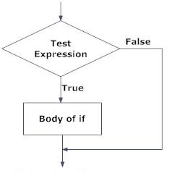
if Statement
Syntax:
if(Boolean_expression)
{
// Body of if
}

Slide 71
Example (if statement)
val age = 18
if (age >= 18) { // Condition: if age is greater than or equal to 18
println("You are eligible to vote.") // This will execute if the condition is true
}

Slide 72
if-else Statement
Syntax
if(Boolean_expression){
// Body of if statement
}else{
// Body of else statement
}

Slide 73
Example (if-else)
val marks = 45
if (marks >= 40) { // Condition: if marks are greater than or equal to 40
println("You have passed the exam.") // Executes if the condition is true
} else {
println("You have failed the exam.") // Executes if the condition is false
}

Slide 74
if…else if…else Statement
Syntax:
if(Boolean_expression1){
// Body of if statement
}
else if(Boolean_expression2){
//Body of else if
}
else{
// Body of else statement
}

Slide 75
Example (if-else-if)
val temperature = 30
if (temperature > 35) { // First condition
println("It's very hot outside.")
} else if (temperature >= 25) { // Second condition
println("The weather is warm.")
} else {
println("It's quite cool outside.") // Default case
}

Slide 76
Methods and Functions in Scala

Slide 77
Function
A function or a method is a block of code that performs a specific task.
That block of code is then given a name that is called whenever that specific task needs to be performed.
Functions take in an input, known as an argument. Then perform some operations on that input and then resulting output.

Slide 78
Types of functions
Functions can be divided into two broad categories:
Built-In Functions
User-Defined Functions
Built-In functions are known as methods.
val printMe=“hello world”
Println(printMe)

Slide 79
Calling a function
Most methods require you to call them on something, lets call that something an object.
In scala two ways are there to call a function:
objectName.methodName(arguments)
objectName methodName arguments

Slide 80
Example 1
val string1 = “hello world”
val result = string1.indexOf(‘w’)
println(result)

Slide 81
Example 2
val string1 = “hello world”
val result = string1 indexOf ‘w’
println(result)

Slide 82
User defined function in Scala
def functionName(parameters:typeofparameters):returntypeoffunction={
//statements to be executed
}

Slide 83
User Defined function in Scala
def sayhello(){
println("Hello")
}
sayhello: ()Unit return whenever we don’t have any return type for a function.

Slide 84
With Parameters
def sum(a:Int,b:Int)
{
println(a+b)
}

Slide 85
With parameters and return type
def sum(a:Int,b:Int):Int={
return a+b
}

Slide 86
UDF to check even odd number
def check(a:Int)
{
if(a%2==0)
{
print("even number")
}else
{
print("odd number")
}
}

Slide 87
Strings in Scala
To declare a string we have two methods i.e.
Using type inference
Without using type inference.

Slide 88
String without type inference
val myFirstString: String = “hello scala”
println(myFirstString)
Here we are specifying the type as string.

Slide 89
String with type inference
val myFirstString = “hello scala”
println(myFirstString)
Here we are not specifying the type as string so it will automatically recognize the type string.

Slide 90
Scala with Java
Scala’s string is built on java’s String with added unique features.
Example:
val stringVar = “what is the length of string”
println(stringVar.length())
Length() is a java’s method can be can use in scala as well.

Slide 91
String concatenation
println(“hello” + “world”)
val string1=“hello”
val string2=“world”
print(string1+string2)

Slide 92
String Interpolation
String interpolation is the ability to create new strings or modify existing ones by embedding them with expressions.
Three methods for string interpolation i.e.
String Interpolation with ‘s’:
String Interpolation with ‘f’:
String Interpolation with ‘raw’:

Slide 93
String Interpolation with ‘s’
For String interpolation with s, we prepend an s to any string literal.
This allows us to use variables inside a string.
Syntax for single variable EXpressions:
s”optional String $VariableIdentifier optional String”

Slide 94
Example
Val name=“sam jones”
Println(s”my name is $name!”)

Slide 95
Syntax for expressions with Non-Identifier Characters
s”optional String ${expression} optional string”
Example:
println(s”3+4=${3+4}”)

Slide 96
String interpolation with ‘f’
For string interpolation with f, we prepend an f to any string literal.
The f prepended before the string is letting the compiler know that the string should be processed using the f interpolator.
Syntax:
f”string $variableIdentifier%Formatspecifier String”

Slide 97
Example
val pi=3.14159F
println(f”the value of pi is $pi%.2f”)
So it will output upto 2 decimal point here.

Slide 98
String Interpolation with ‘raw’
The raw string interpolator doesn’t recognize character literal escape sequences.
Example:
1. println(“without Raw:\nFirst\nsecond”)
2. println(raw“with Raw:\nFirst\nsecond”)

Slide 99
Practice Question
Write a Scala program that takes user input for their name and age, and then prints a personalized greeting message using string interpolation. The message should include the user's name and a statement about their age category (e.g., "You are a teenager" for ages 13-19, "You are an adult" for ages 20-59, and "You are a senior" for ages 60 and above).

Slide 100
Solution
import scala.io.StdIn.readLine
import scala.io.StdIn.readInt
val name=readLine("Enter name:\n")
val age=readInt()
if(age>=13 && age <=19)
{
println(s"$name! you are a teenager")
}else if(age>=20 && age<=59)
{
println(s"$name! you are an adult")
}else
{
println(s"$name! you are a senior")
}

Slide 101
Testing String Equality
When strings are equal, it simply means that both strings are composed of the same characters inn the same order.
Example:
val string1=“hi”
val string2=“HI”
val areTheyEqual = string1==string2
Boolean value will be provided as a result.

Slide 102
Creating Multiline Strings
When strings are equal, it simply means that both strings are composed of the same characters in the same order.
Syntax:
keyword variableName=“””StringPart1
StringPart2
StringPart3
…
StringPartn”””

Slide 103
Example
val multilineString=“””this is a
Multiline string
Consisting of
Multiple lines”””
Println(multilineString)

Slide 104
Splitting Strings
Pizza Dough, Tomato sauce, Cheese, Toppings of choice
Pizza Dough
Tomato sauce
Cheese
Toppings of choice

Slide 105
Syntax:
keyword variableName=“str1,str2,….,strn”.split(“,”)
Example:
val splitPizza = “Pizza Dough, Tomato sauce, Cheese, Toppings of choice”.split(“,”)
splitPizza.foreach(println)

Slide 106
Finding Patterns in Strings
“ab*c” | “ab{2,5}c” | “[a-zA-Z]”
“ab+c” | “[abc]” | “[1-9]”
“ab{2}c” | “[abc]+” | “[1-9]+”

Slide 107
Finding Pattern with ab*c
(*) Symbol here denotes that it will match with any number of b in a given equation.
It can match where b=0 to any number.
Example:
ac
abc
abbc
abbbc…….

Slide 108
Finding Pattern with ab+c
(+) Symbol here denotes that it will match with one or any number of b in a given equation.
It can match where b=1 to any number.
Example:
abc
abbc
abbbc…….

Slide 109
Finding Pattern with ab{2}c
It can match where b=2 only.
Example:
abbc

Slide 110
Finding Pattern with ab{2,5}c
Range is specified using {2,5}
It can match where b=2 to 5 only.
Example:
abbc
abbbc
abbbbc
abbbbbc

Slide 111
Finding Pattern with [abc]
It can match with a, b, or c
Example:
a
b
c

Slide 112
Finding Pattern with [abc]+
It can match with a, b, c or any possible combination.
Example:
a
b
c
ab
ac
abc etc….

Slide 113
Finding Pattern with [a-zA-Z]
It can match with all the lower case or upper case letters from a-z.
Example:
A
a
B Etc…

Slide 114
Finding Pattern with [1-9] or [1-9]+
[1-9] will match with all the numbers from 1-9.
[1-9]+ will match with all the possible combination of numbers from 1-9.

Slide 115
Implementing Regular Expressions in Scala
“ab*c”.r

Slide 116
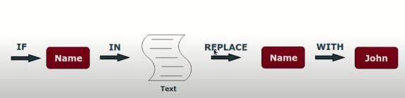
Replacing patterns in strings

Slide 117
Finding patterns in strings
Regex.findFirstIn(“ searchString”)
Regex.findAllIn(“ searchString”)

Slide 118
Pattern finding Example
var var1 = "the".r //reg expression
var var2 = "the big data course“ //String to find from
var var3 = var1.findFirstIn(var2) //stores the match
var3.foreach(println)

Slide 119
Pattern finding Example 2
var var1 = "[1-5]+".r
var var2 = "12 67 93 48 51“
var var3 = var1.findAllIn(var2)
var3.foreach(println)
This will match will all the values containing numbers from 1-5 or any combinations of these.

Slide 120
Pattern matching Example 3
var var1 = "[1-5]{2}+".r
var var2 = "12 67 93 48 51“
var var3 = var1.findAllIn(var2)
var3.foreach(println)
Here it will only match those patterns where length will be 2.

Slide 121
Replacing patterns in strings
searchString.replaceFirst(“ Regex”, “ReplaceExpression”)
searchString.replaceAll(“Regex”, “ReplaceExpression”)
OR
Regex.replaceFirstIn(“ searchString”, “ReplaceExpression”)
Regex.replaceAllIn(“searchString”, “ReplaceExpression”)

Slide 122
Replacing Strings Example (numbers)
var var1 = "8201530“
var var2 = var1.replaceFirst("[01]","x")
println(var2)
It will replace the first 0 or 1 to X.

Slide 123
Replacing Strings Example (strings sequence)
var var1 = "H".r
var var2 = "Hello world“
var var3 = var1.replaceFirstIn(var2,"J")
var3.foreach(println)
It will replace h to j in hello.

Slide 124
Replace All Example
var var1 = "8201530“
var var2 = var1.replaceAll("[01]","x")
println(var2)
It will replace all the 0 or 1 to X.

Slide 125
Example
var regularExp = “[a-z]+“.r
var replaceIn=“dk79rx5c4lj2c8ge”
var replaced = regularExp.replaceAllIn(replaceIn,“1")
println(replaced)
It will replace all the a-z to 1.

Slide 126
Methods for Comparing Strings
variableName.equals(VariableName)
String1.compareTo(String2)
variableName.equalsIgnoreCase(variableName)

Slide 127
Example ComparingString
val str1= “ABC”
val str2=“ABC”
val comparingStrings=str1.equals(str2)
println(comparingStrings)

Slide 128
Example (compareTO())
val str1= “This is scala”
val str2=“Hello Scala”
val str3=“Hello Scala”
val comparingStrings=str1.compareTo(str2)
val comparingStrings2=str2.compareTo(str3)
println(comparingStrings)

Slide 129
Previous example compares the string lexographically.
I.e:
If both strings are same then answer will be 0.
If we are getting a positive number that means string1 is greater than string2.
If we are getting a negative number that means string1 is smaller than string2.

Slide 130
Example equalsIgnoreCase
val str1= “ABC”
val str2=“abc”
val comparingStrings=str1.equalsIgnoreCase(str2)
println(comparingStrings)

Slide 131
Practice Question
Write a Scala program that takes an integer input and prints whether the number is positive, negative, or zero. (using function)

Slide 132
Solution
def checkSign(num: Int): String = {
if (num > 0) "Positive"
else if (num < 0) "Negative"
else "Zero"
}
println(checkSign(5))

Slide 133
Practice Question
Write a Scala program that takes a year as input and prints whether it is a leap year or not. (using function)

Slide 134
Solution
def isLeapYear(year: Int): Boolean = {
(year % 4 == 0 && year % 100 != 0) || (year % 400 == 0)
}
println(isLeapYear(2020))

Slide 135
Practice Question
Write a Scala program that takes three integers as input and prints the maximum of the three. ( using functions)

Slide 136
Solution
def maxOfThree(a: Int, b: Int, c: Int): Int = {
if (a >= b && a >= c) a
else if (b >= a && b >= c) b
else c
}
println(maxOfThree(10, 5, 8))

Slide 137
Classes and object

Slide 138
Classes are Blueprints
A blueprint is a guide used for making something.
In the real world, blueprints are usually plans for making buildings.
Classes can be thought of as a blueprint with which you can create an object.
An object is an instance of a class which is the actual thing to be used in our programs.
In the same way, a single house is an instance of the blueprint.

Slide 139
The Blueprint will specify the properties the object would have and will also specify the operations/methods which the object can use.
The properties and methods of a class are known as the members of that class.
Example:
A person can perform certain actions such as walking and talking.
These are the methods of our function class.
Every person has a name, a gender, and an age. These are the properties of our person class.

Slide 140
Built in Classes
Classes in Scala are broadly divided into two categories i.e. built-in classes and user-defined classes.
When we define a string, we are actually creating an instance/object of the string class.
Methods such as length and toUpperCase are all members of the string class which can be used by an object of that class.

Slide 141
Collection Library in Scala
You can think if collections as vessels used for collecting data and Scala has a vast library of them.
Each Scala collection is one of two types: mutable collections or immutable collection.

Slide 142
Mutable collections
Mutable collections are collections which can be updated.
Elements can be added to the collection and can be removed or manipulated.

Slide 143
Immutable collection
Immutable collections cannot be updated.
When you add, remove, or manipulated an element in an immutable collection, you are creating a new collection and leaving the old one unchanged.

Slide 144
Sequences, Sets and Maps
The collection library takes on a hierarchical structure.
At the top of the library, there are three main categories of collection classes i.e.
Sequence – Seq
Sets – Set
Maps – Map
All three contains both mutable and immutable collections.

Slide 145
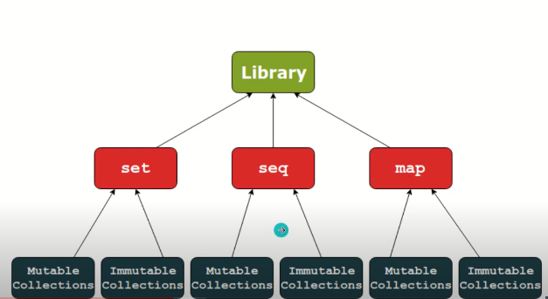

Slide 146
Sequences
Collections which are part of the Seq Class, store elements at fixed index positions, with the index starting at 0.
Each element has a specified location in the sequence and therefore, can be located very easily.
Seq(2,4,6,8,10)

Slide 147
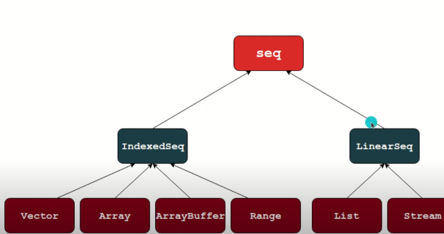
Sequences
The sequence class is further divided into two classes i.e. IndexedSeq and LinearSeq.

Slide 148
Sets
Collections which are the Set class contain sets of elements with no element existing more than once, I.e. no duplicates.
Example:
Set(“apple”, “orange”, “banana”, “grape”)

Slide 149
Maps
Collections which are of the Map class consists of pairs of keys and values with each value being associated with a unique key.
(Key,value)
Example:
Map((“a”,25) (“b”,50))

Slide 150
Difference b/w Sequences, Set, & Map
For sequence collections, the argument passed to apply specifies an index. Apply returns the element at the specified index.
For the Set collections, the argument passed to apply is an element in the specified collection. Apply returns true if the element is in the specified collection and false if it isn’t.
For Map collections, the argument passed to apply specifies a key. Apply returns the value of the specified key.

Slide 151
Sequences Example
val seqCollection = Seq(2,4,6,8,10);
val result = seqCollection.apply(1);
println(result)

Slide 152
Set Example
val setCollection = Set("apple", "Orange", "Grapes", "Banana");
val result = setCollection.apply("Orange");
println(result);

Slide 153
Map Example
val mapCollections = Map(("a", 97), ("b", 98), ("c", 99), ("d", 100))
val result = mapCollections.apply("c")
println(result)

Slide 154
Foreach : A collection method in Scala
We cannot simply use println or print as they are used to print single values and collections are a collection of values.
The foreach method is called on a collection of any type and takes a single argument.
Syntax:
collectionName.foreach(method)
For printing the elements of a collection, we would need to apply the println or print method to each element.

Slide 155
Example
Val collection = Seq(2,4,6,8,10)
collection.foreach(println)

Slide 156
Array collections in Scala
Arrays in Scala are collections which come under the sequence class.
They are the mutable collections, hence when elements in an array are modified, the original array is updated.

Slide 157
Creating and Populating an Array
Keyword Array followed by () in which mention the elements you want to populate your array with.
Syntax:
Val arrayName=Array(element 1, element 2………, element n)

Slide 158
With New
What if we don’t initially know what we want to populate our array with?
For this we will use the new Keyword.

Slide 159
Example
var arr1 = new Array[String](3)
arr1(0) = "red"
arr1(1) = "blue"
arr1(2) = "Yellow"
arr1.foreach(println)

Slide 160
How to populate an array
Multiple methods are there to populate an array in Scala.
Using range
Using fill
Using toArray

Slide 161
Using range
val array1 = Array.range(0,5)
// range(start,end )
// range(start,end, difference)
array1.foreach(println)

Slide 162
Using fill
val array3 = Array.fill(2)(“Hello”)
// fill( number of elements)(value)
array3.foreach(println)

Slide 163
Using toArray
val array4 = “hello”.toArray
//converts arguments to an array
array4.foreach(println)

Slide 164
Accessing elements of an Array
arrayName(index of element2)

Slide 165
Length of an array
val intArray = Array(17,34,23,6,50)
val len = intArray.length
println(len)

Slide 166
Sequence class operations on arrays Example
var arr1 = Array.range(0,10)
var arr2 = arr1.filter(_ % 2 == 0)
var arr3 = arr2.map(_ * 2)
var arr4 = arr3.reverse

Slide 167
ArrayBuffers
An ArrayBuffer in Scala is a collection that comes under the sequence class.
Like arrays it is a mutable collection.
You can add and remove elements from an ArrayBuffer
Array methods and operations are also available for ArrayBuffers.

Slide 168
Creating an ArrayBuffer
To be able to use an ArrayBuffer, we first need to import it using the package scala.collection.mutable.ArrayBuffer.
Syntax:
val arrayBufferName= new ArrayBuffer[DataType] ()
No size of array is mentioned here.

Slide 169
Adding Elements
To add an element to an ArrayBuffer we use the assignment operator +=.

Slide 170
Example of ArrayBuffer creation
import scala.collection.mutable.ArrayBuffer
var myarraybuffer = ArrayBuffer(1,2,3,4,5)
myarraybuffer.foreach(println)
Here we have provided elements as well while creating ArrayBuffer.

Slide 171
Example (Add element in ArrayBuffer)
import scala.collection.mutable.ArrayBuffer
var myarraybuffer = ArrayBuffer[Int]()
myarraybuffer += 6
myarraybuffer += 15
myarraybuffer += 78
myarraybuffer += 4
myarraybuffer.foreach(println)

Slide 172
Deleting Elements
We can delete elements from ArrayBuffer using -= assignment operator or remove method or clear method.

Slide 173
Example
var myarraybuffer = ArrayBuffer(1,2,3,4,5)
myarraybuffer -= 5
myarraybuffer.foreach(println) // using -=
myarraybuffer.remove(2) // using remove method
myarraybuffer.foreach(println)
myarraybuffer.clear() // using clear method
myarraybuffer.foreach(println)

Slide 174
Lists in Scala
A list in Scala is a collection which comes under the seq class.
It is an immutable collection and hence when modified the original list does not get updated, rather a new list is created.

Slide 175
Create a list
Lists can be created and populated in multiple ways.
Example:
val fruitList=List(“orange”, “banana”, “apple” , “grapes”)
fruitList.foreach(println)

Slide 176
Example
val intList=List.range(1,10)
intList.foreach(println)

Slide 177
Create a list using fill method
val myList=List.fill(3)(“ABC”)
myList.foreach(println)
Here ABC will be filled 3 times into myList

Slide 178
Constructing Lists Using :: and nil
:: is a method, known as cons, which takes two arguments.
The first argument is the head and is a single element.
The second argument is a tail which is another list.
Nil is used to represent an empty list and is always used when constructing a list with ::

Slide 179
Syntax
element_x :: element_xs

Slide 180
Appending Elements
To add an element to a list we use :+ method.
Example:
val list1 = "a"::"b"::"c"::"d"::"e"::Nil
val list2 = list1 :+ "p" ---------- Appending element
list2.foreach(println)

Slide 181
Prepending Elements
1st method – using Cons ::
2nd method – using +: method
Example using ::
val list3 = "w"::list2
Example using +:
val list4 = "m" +: list3
list4.foreach(println)

Slide 182
List Concatenation
List concatenation is done using the ::: method.
Example:
val list1 = List("a","b","c","d","e")
val list2 = List("x","y")
val list3 = list1 ::: list2

Slide 183
Head & Tail
To get the head and tail of a list or any collection for that matter, we use the head and tail method.
Example head:
val getHead=list1.head //represent first single element
Example Tail:
val getTail=list1.tail // represents remaining elements

Slide 184
Lazy List in Scala
A lazylist is an immutable sequence type collection, very similar to lists.
We call it lazy because it computes its elements only when they are needed.
Similar to the :: method used for creating lists, lazylists are created with the #:: method.
We use LazyList.empty to end a LazyList which is equivalent to the Nil used for ending a list.

Slide 185
LazyList Syntax
head #:: tail #:: LazyList.empty
LazyList actually comes in picture when we want to create a list of elements from 1 to 10000000000.

Slide 186
Example
val list1 = 1 #:: 2 #:: 3 #:: 4 #:: 5 #:: LazyList.empty

Slide 187
List vs LazyList
val list3 = List.from(1 to 100000000)
If we create a list using above syntax then it will take long time to create a list with these number of elements as well as you will get an error.
val list3 = LazyList.from(1 to 100000000)
Same thing can be done easily using LazyList.

Slide 188
Vector in Scala
Like Lists, Vectors are another immutable collection of sequence type.
They differ in the fact that lists are linear while vectors are indexed.
Vectors can be created using the Vector keyword followed by ().
You can initialize an empty vector using the empty method.
Vector element can be accessed by :
vectorName(index of element)

Slide 189
Vector in Scala
In order to append an element to vector we use can :+ method.
To prepend an element to vector we have to use +: method.
Vector concatenation is done using the ++ method.

Slide 190
Vector creation
val vector1 = Vector(1,2,3,4,5)
val vector2 = Vector.empty // initialize empty vector
val vector3 = Vector("a","b","c")
val vector4 = vector3 :+ "d“ //append
val vector5 = "Z" +: vector4 //prepend

Slide 191
Example
val nvector = Vector("e","f")
val nvector1 = vector5 ++ nvector
println(nvector1)
nvector1.foreach(println)

Slide 192
Streams
In older versions of Scala before 2.13 we used to use streams, instead of LazyLists.
The only difference is that while lazylists are completely lazy, streams compute the head element even when not required.

Slide 193
Stream Example
val stream = 1 #:: 2 #:: 3 #:: Stream.empty

Slide 194
Functions in Scala
Syntax:
def functionName(parameters) : returnType = { function body }
First function in Scala
def sum(x:Double, y:Double):Double = { x+y }
Calling a function:
val total = sum(2,3)

Slide 195
Def is the keyword used for defining a function
Sum is the name of the function.
() in which define the function parameters separated by commas.
After defining the function’s return type, we insert a =.
The body of the function is wrapped in curly brackets {}.

Slide 196
Calling functions within function
def square(x:Double) = { x*x }
val result = square(5)
print(result)
def squareSum(x:Double, y:Double) = { square(x) + square(y) }
val result = squareSum(2,5)
print(result)

Slide 197
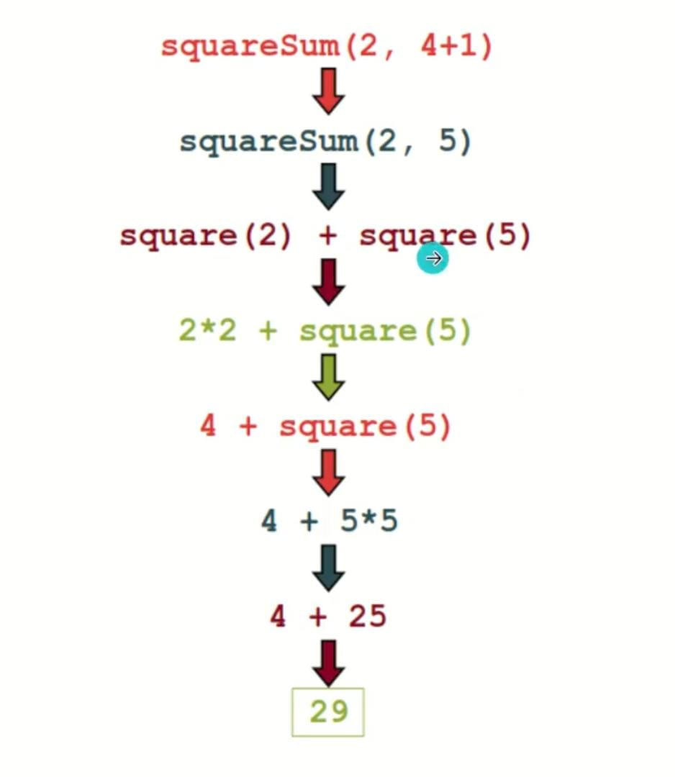
Call by value

Slide 198
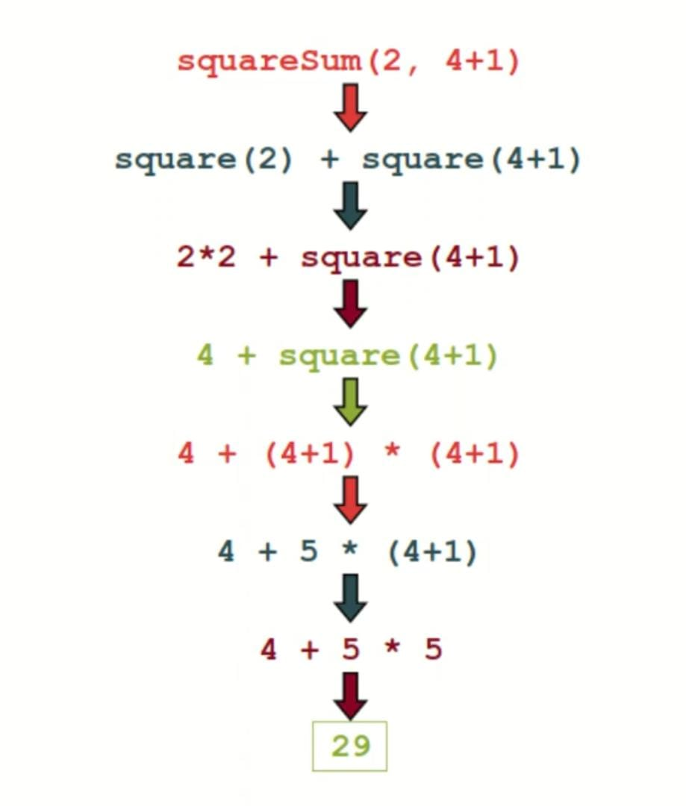
Call by Name

Slide 199
Recursive Function
def fac(x:Int) : Int ={if(x == 1) 1 else x *fac(x-1)}
println(fac(4))

